Slide 1
SENG 1000 - Software Engineering Foundations and Practice
-Sumati

Slide 2
Topics
Defining new Python Classes
Container Classes
Overloaded Operators
Inheritance
User-Defined Exceptions

Slide 3
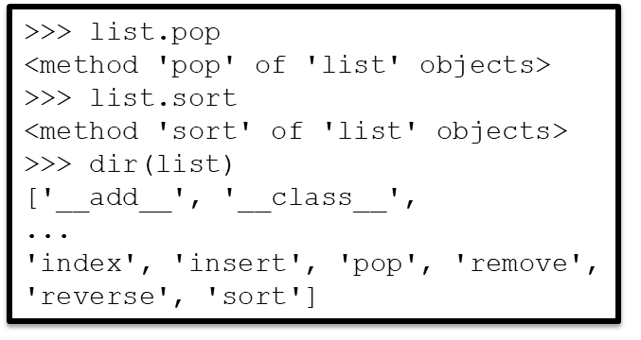
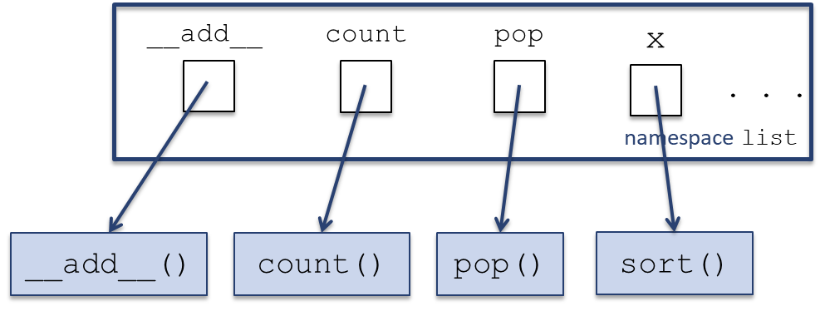
A class is a namespace
A class is really a namespace
The name of this namespace is the name of the class
The names defined in this namespace are the class attributes (e.g., class methods)
The class attributes can be accessed using the standard namespace notation

Slide 4


Class methods
A class method is really a function defined in the class namespace; when Python executes
it first translates it to
and actually executes this last statement
The function has
an extra argument,
which is the object
invoking the method

Slide 5





Class methods

Slide 6
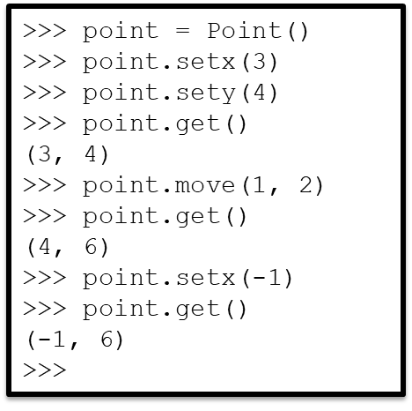
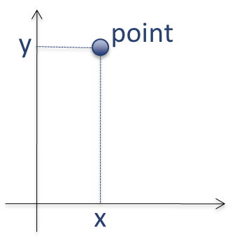
A new class: Point
Suppose we would like to have a class that represents points on a plane for a graphics app, say
Let’s first informally describe how we would like to use this class
How do we create this new class Point?

Slide 7
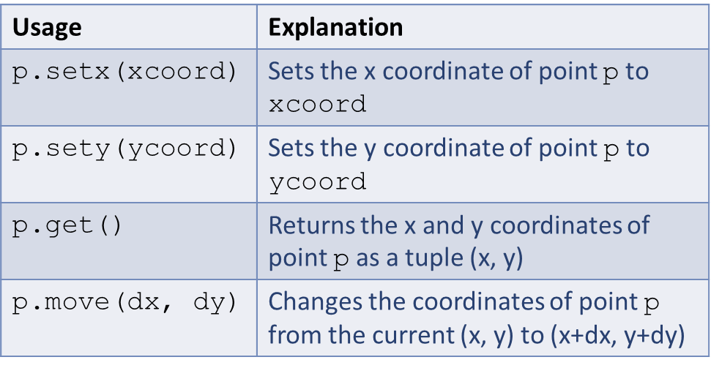
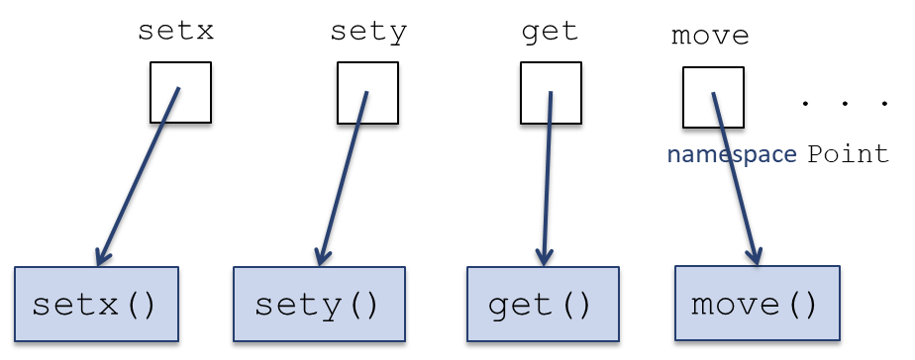
Developing the class Point
A namespace called Point needs to be defined
Namespace Point will store the names of the 4 methods (the class attributes)

Slide 8

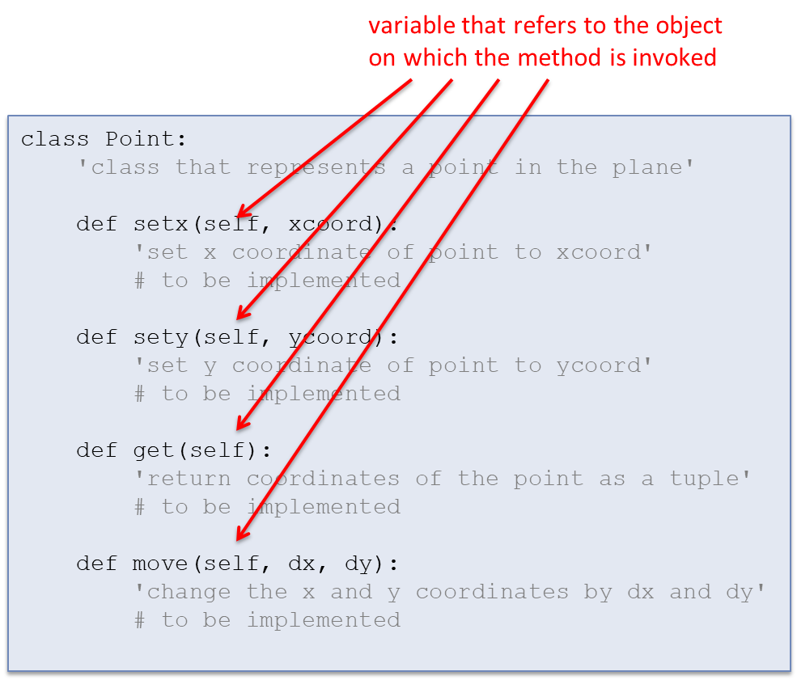
Developing the class Point
Each method is a function that has an extra (first) argument which refers to the object that the method is invoked on
The Python class statement defines a new class (and associated namespace)

Slide 9
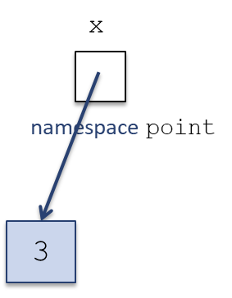
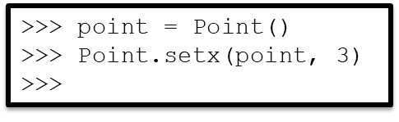
The object namespace
We know that a namespace is associated with every class
A namespace is also associated with every object

Slide 10
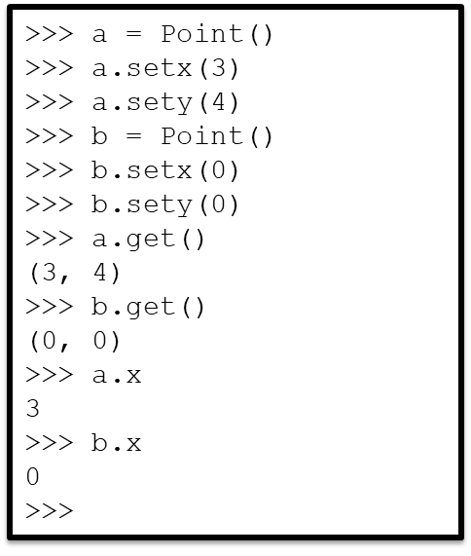
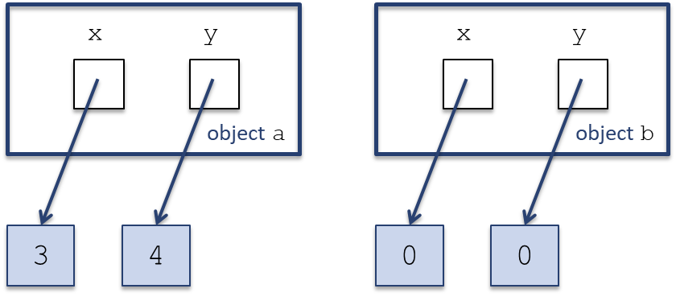
The instance namespaces
Variables stored in the namespace of an object (instance) are called instance variables (or instance attributes)
Every object will have its own namespace and therefore its own instance variables

Slide 11
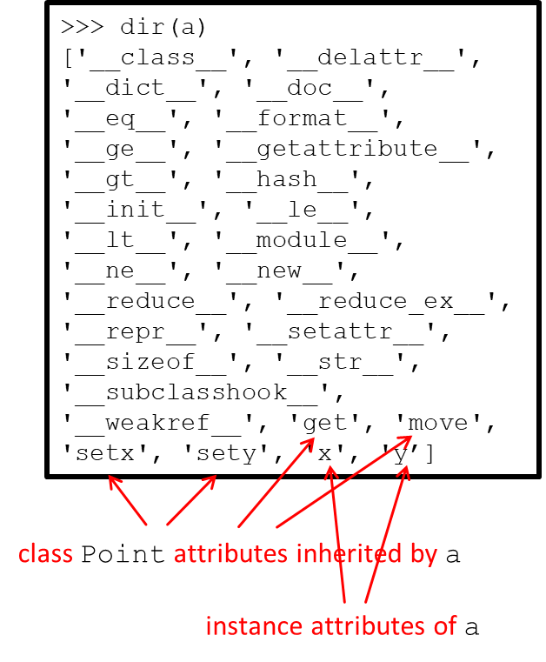
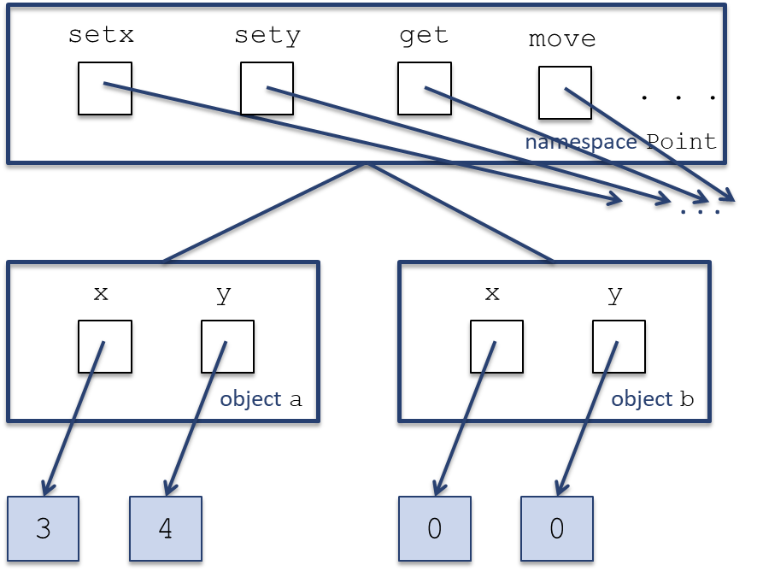
The class and instance attributes
An instance of a class inherits all the class attributes
Function dir() returns the attributes of an object, including the inherited ones

Slide 12
The class and instance attributes
Method names setx, sety, get, and move are defined in namespace Point, not in namespace a or b.
Python does the following when evaluating expression a.setx:
It first attempts to find name setx in object (namespace) a.
If name setx does not exist in namespace a, then it attempts to find setx in namespace Point

Slide 13
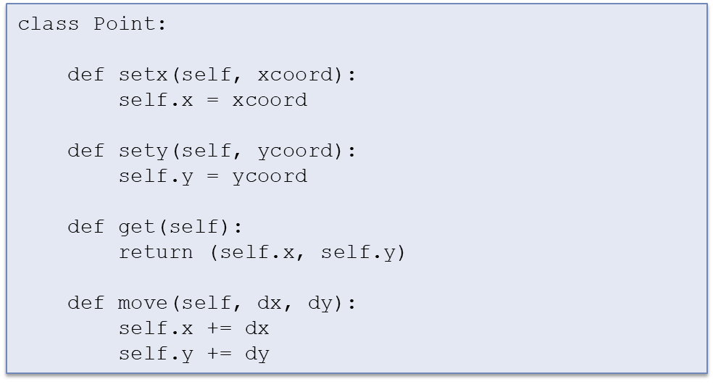
Class definition, in general

Slide 14
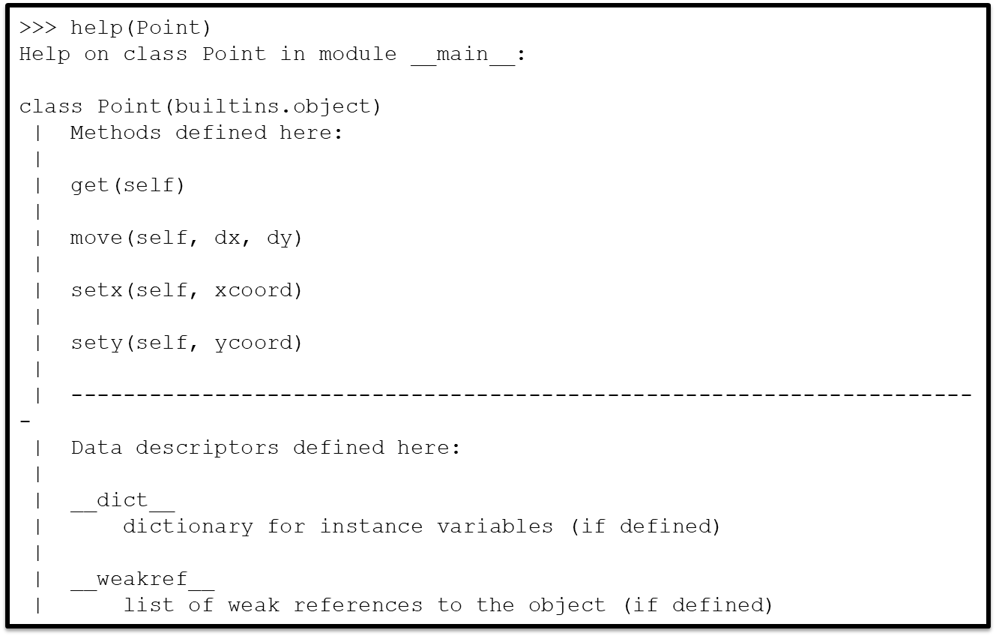
(No) class documentation

Slide 15
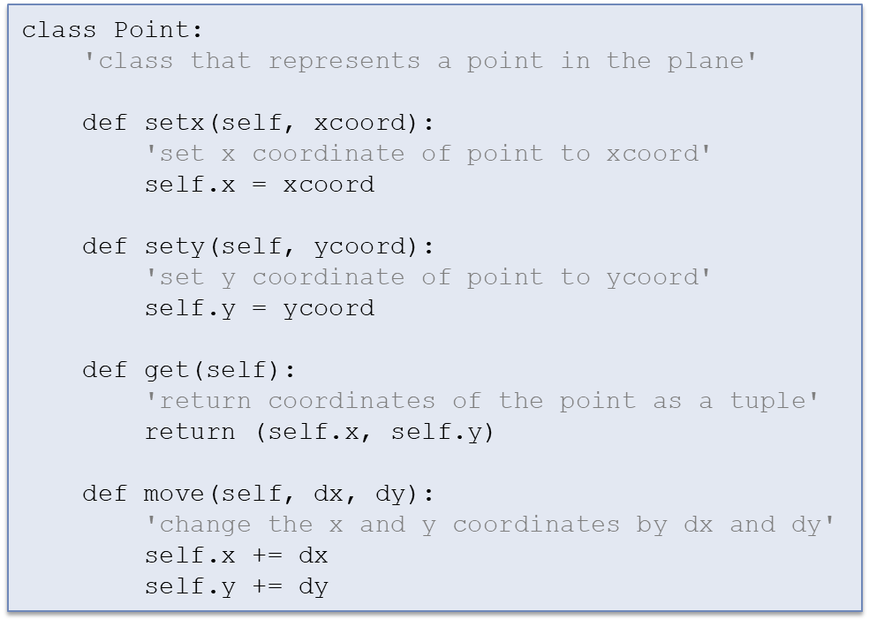
Class documentation

Slide 16
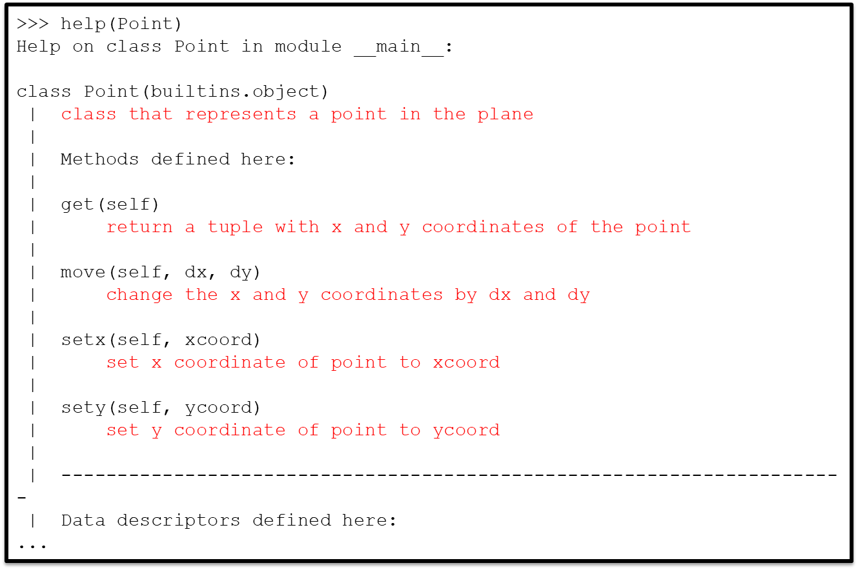
Class documentation

Slide 17
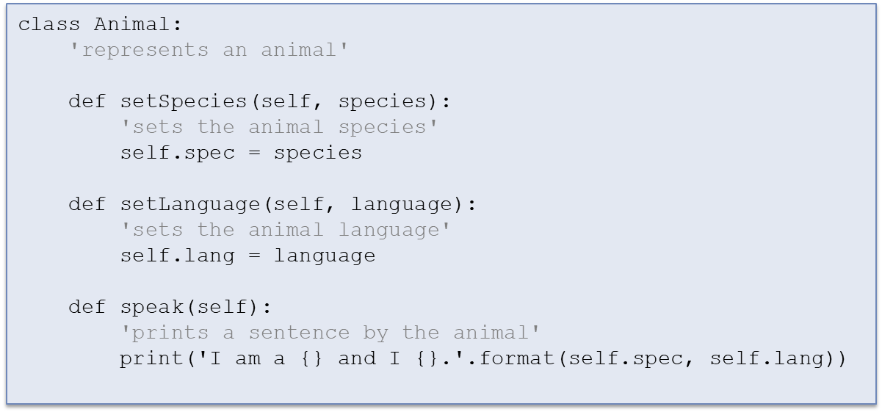
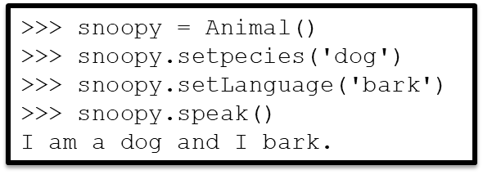
Exercise
Develop class Animal that supports methods:
setSpecies(species)
setLanguage(language)
speak()

Slide 18
Constructor

Slide 19
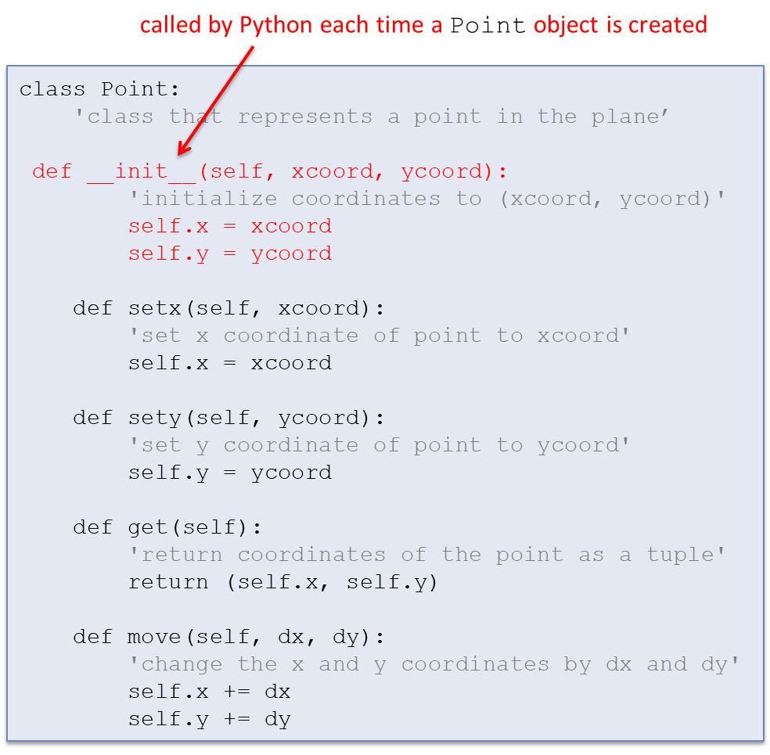
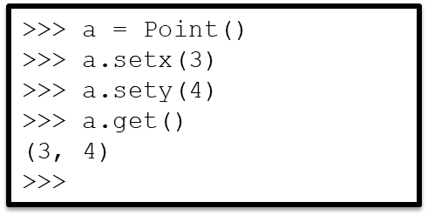
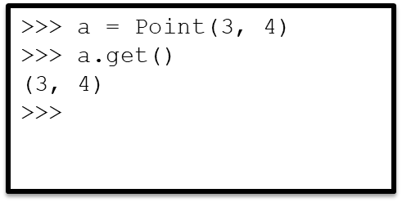
Overloaded Constructor
It takes 3 steps to create a Point object at specific x and y coordinates

Slide 20
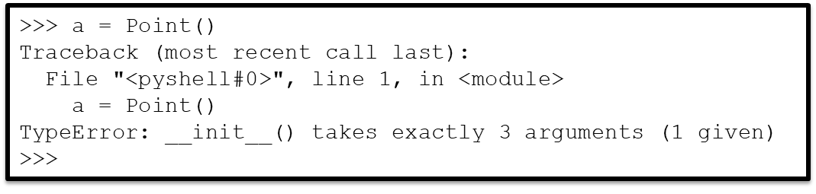
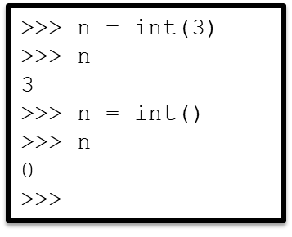
Default Constructor
Problem: Now we can’t create an uninitialized point
Built-in types support default constructors
>>> a = Point()
>>> a.get()
(0, 0)
>>>

Slide 21
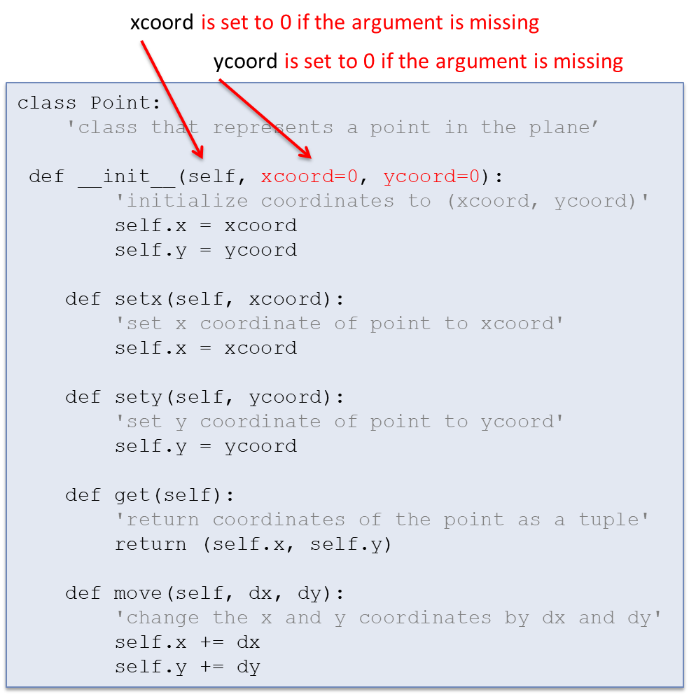
Default Constructor
Want to augment class Point so it supports a default constructor

Slide 22
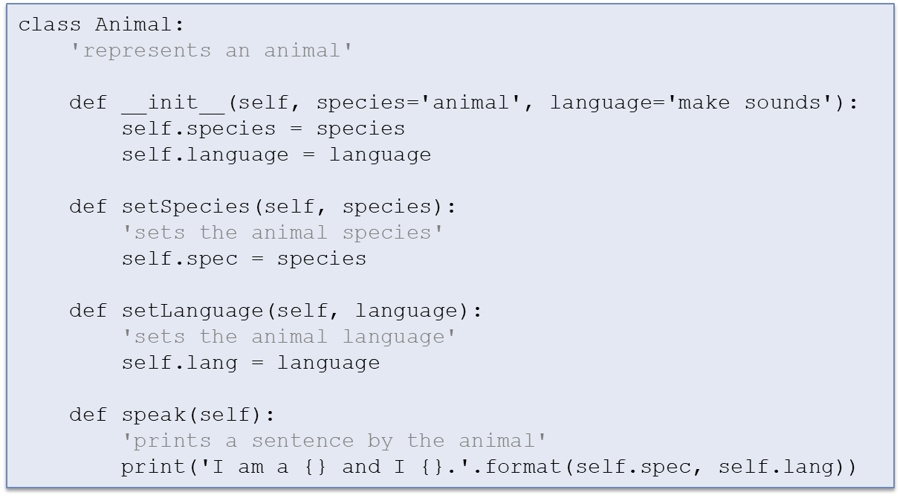
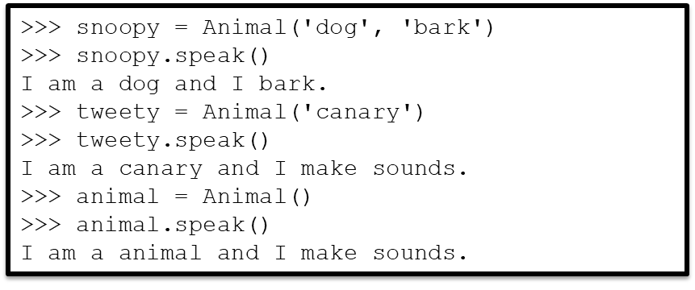
Exercise
Modify the class Animal we developed in the previous section, so it supports a two, one, or no input argument constructor

Slide 23
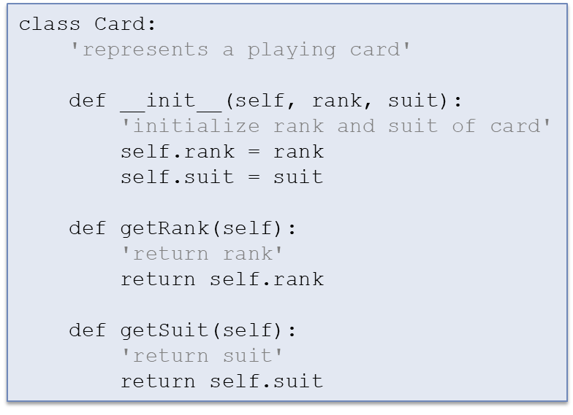
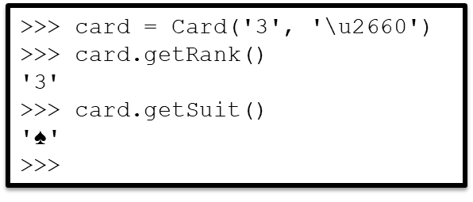
Example: class Card
Goal: develop a class Card class to represent playing cards.
The class Card should support methods:
Card(rank, suit): Constructor that initializes the rank and suit of the card
getRank(): Returns the card’s rank
getSuit(): Returns the card’s suit

Slide 24
Container class: class Deck
Goal: develop a class Deck to represent a standard deck of 52 playing cards.
The class Deck should support methods:
Deck(): Initializes the deck to contain a standard deck of 52 playing cards
shuffle(): Shuffles the deck
dealCard(): Pops and returns the card at the top of the deck
>>> deck = Deck()
>>> deck.shuffle()
>>> card = deck.dealCard()
>>> card.getRank(), card.getSuit()
('2', '♠')
>>> card = deck.dealCard()
>>> card.getRank(), card.getSuit()
('Q', '♣')
>>> card = deck.dealCard()
>>> card.getRank(), card.getSuit()
('4', '♢')
>>>

Slide 25
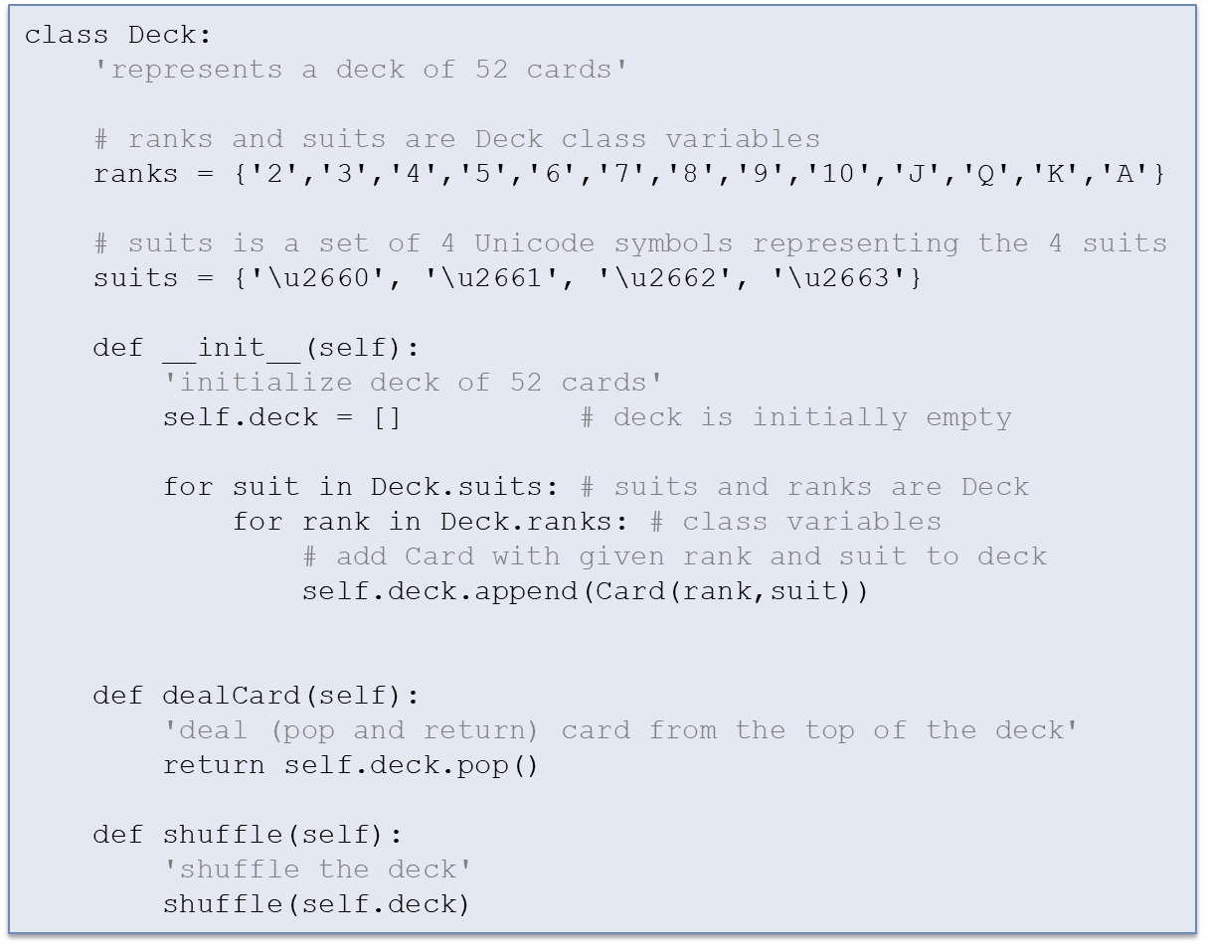
Container class: class Deck

Slide 26
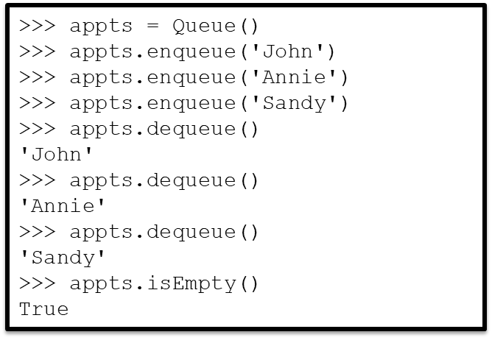
Container class: class Queue
Goal: develop a class Queue , an ordered collection of objects that restricts insertions to the rear of the queue and removal from the front of the queue
The class Queue should support methods:
Queue(): Constructor that initializes the queue to an empty queue
enqueue(): Add item to the end of the queue
dequeue(): Remove and return the element at the front of the queue
isEmpty(): Returns True if the queue is empty, False otherwise

Slide 27
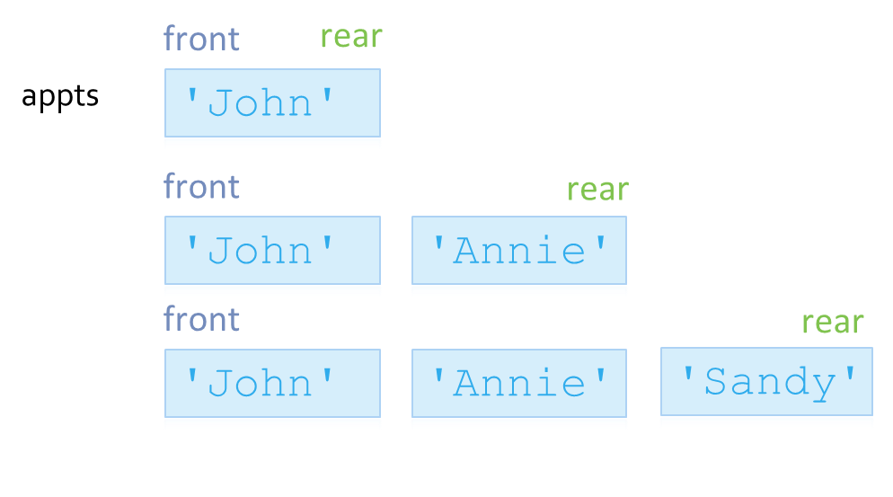
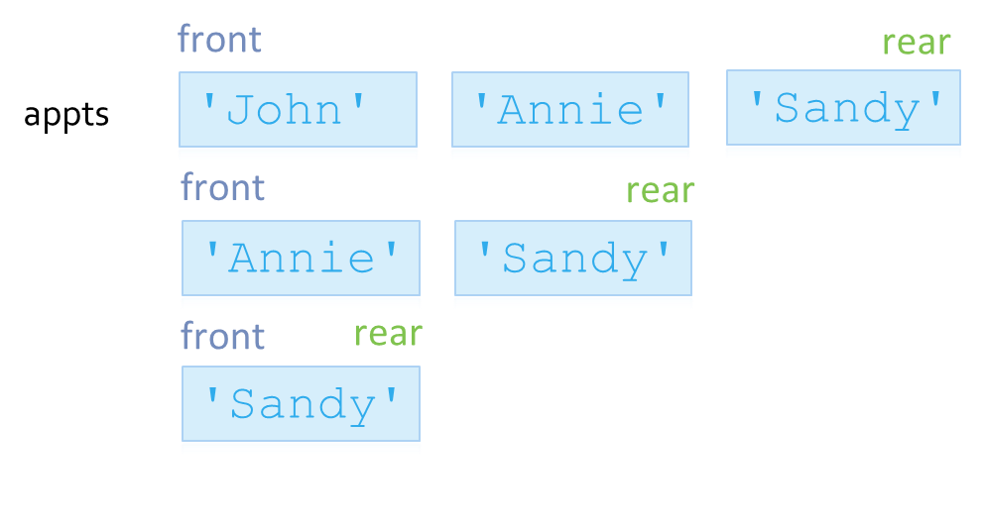
Container class: class Queue
Enqueue:
Dequeue:

Slide 28
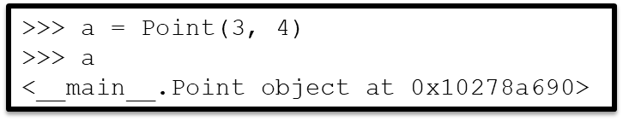
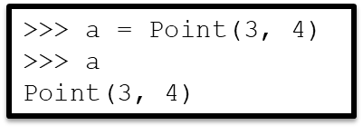
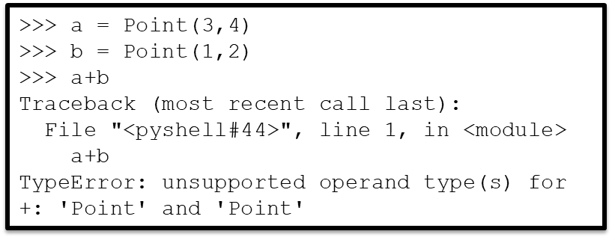
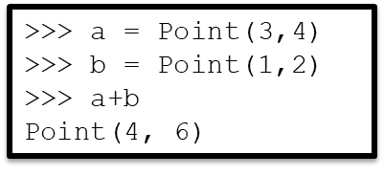
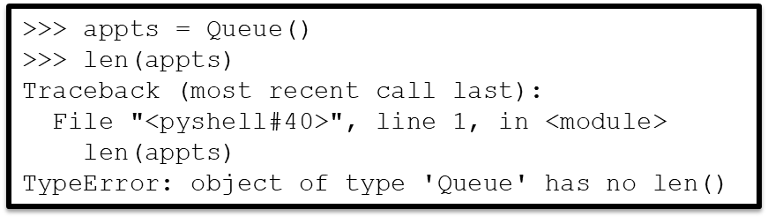
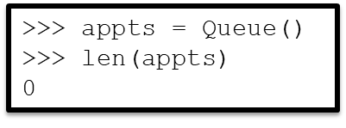
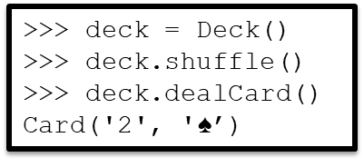
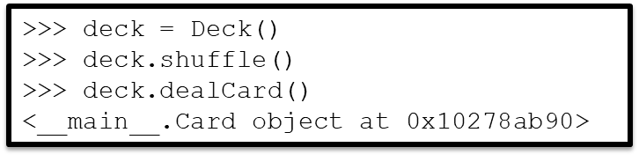
Our classes are not user-friendly
What would we prefer?
(x and y coordinates are added, respectively)

Slide 29


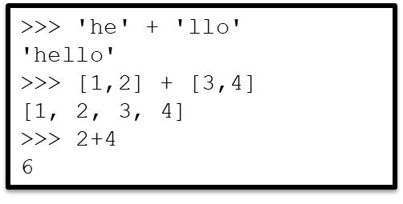
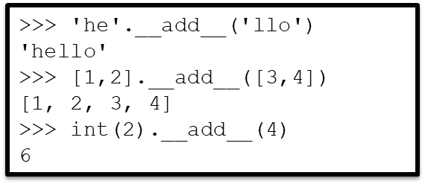
Python operators
Operator + is defined for multiple classes; it is an overloaded operator.
For each class, the definition—and thus the meaning—of the operator is different.
integer addition for class int
list concatenation for class list
string concatenation for class str
How is the behavior of operator + defined for a particular class?
Class method __add__() implements the behavior of operator + for the class
When Python evaluates
… it first translates it to method invocation …
… and then evaluates
the method invocation

Slide 30
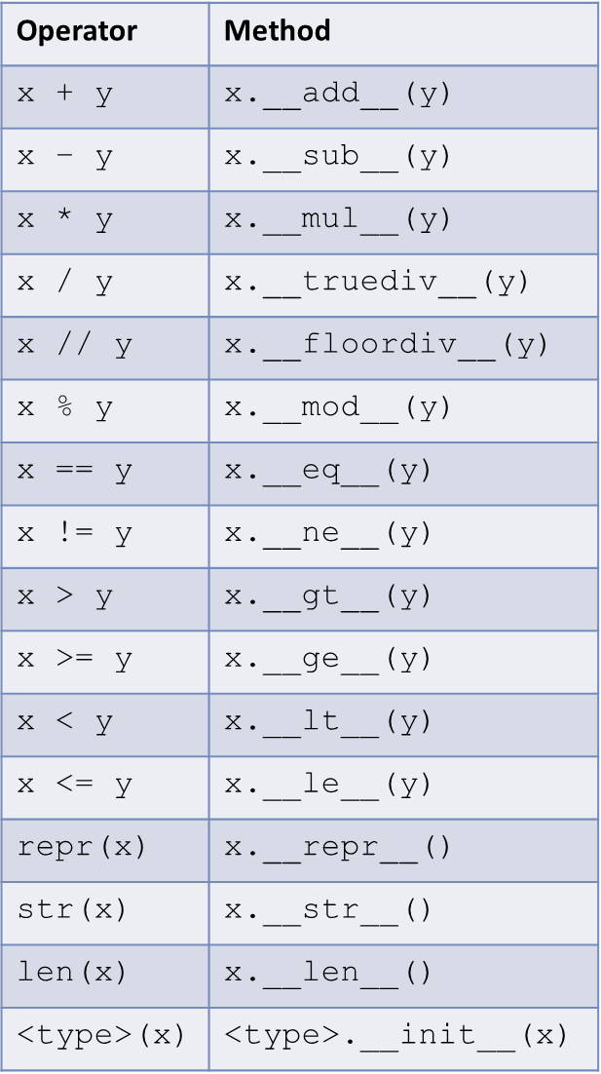
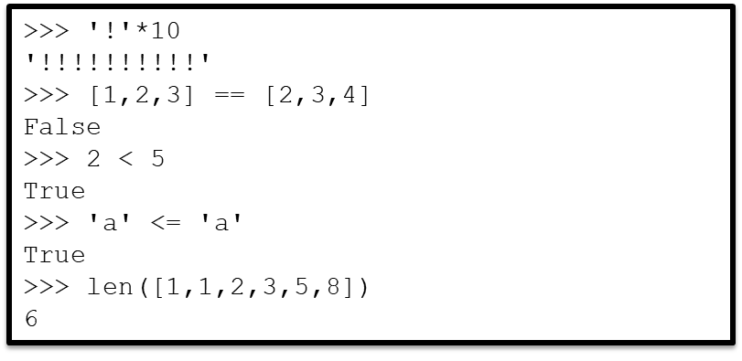
Python operators
In Python, all expressions involving operators are translated into method calls
(Recall that method invocations are then further translated to function calls in a namespace)

Slide 31
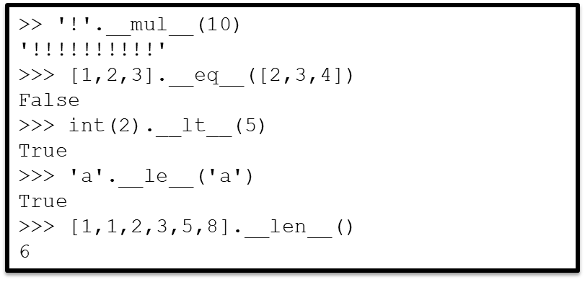
Python Operators

Slide 32
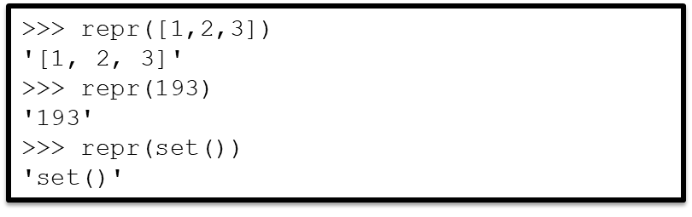
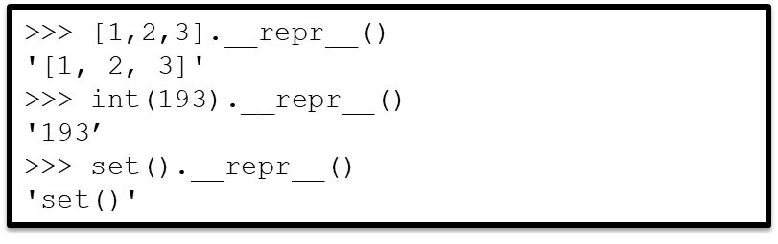
Python Operators
Built-in function repr() returns the canonical string representation of an object
This is the representation printed by the shell when evaluating the object
>>> [1,2,3]
[1, 2, 3]
>>> 193
193
>>> set()
set()

Slide 33
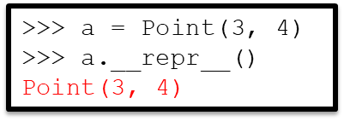
Overloading repr()
In Python, operators are translated into method calls
To add an overloaded operator to a user-defined class, the corresponding method must be implemented
To get this behavior
method __repr__() must be implemented and added to class Point

Slide 34
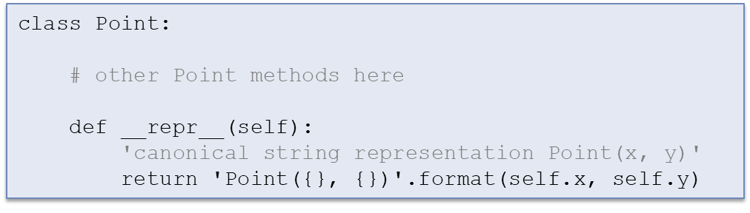
Overloading repr()
__repr__() should return the (canonical) string representation of the point

Slide 35



Overloading operator +
To get this behavior
method __add__() must be implemented and added to class Point
__add__() should return a new Point object whose coordinates are the sum of the coordinates of a and b
Also, method __repr__() should be implemented to achieve the desired display of the result in the shell

Slide 36


Overloading operator len()
To get this behavior
method __len__() must be implemented and added to class Queue
__len__() should return the number of objects in the queue
i.e., the size of list self.q

Slide 37


Exercise
Modify Deck and/or Card to get this behavior

Slide 38

Exercise

Slide 39

str() vs repr()
Built-in function repr() returns the canonical string representation of an object
This is the representation printed by the shell when evaluating the object
Built-in function str() returns the “pretty” string representation of an object

Slide 40


str() vs repr()
This is the representation printed by the print() statement and is meant to be readable by humans

Slide 41


str() vs repr()
Built-in function repr() returns the canonical string representation of an object
This is the representation printed by the shell when evaluating the object
Built-in function str() returns the “pretty” string representation of an object
This is the representation printed by the print() statement and is meant to be readable by humans

Slide 42

Canonical string representation
Ideally, this is also the string used to construct the object
e.g., '[1, 2, 3]' , 'Point(3, 5)’
In other words, the expression
eval(repr(o))

Slide 43


Overloading operator ==
For user-defined classes, the default behavior for operator == is to return True only when the two objects are the same object.
Usually, that is not the desired behavior
It also gets in the way of satisfying the contract between constructor and repr()
For class Point, operator == should return True if the two points have the same coordinates

Slide 44


Exercise
We have already modified class Card to support function repr().
Now implement operator == so two cards with same rank and suit are equal.

Slide 45

Inheritance
Code reuse is a key software engineering goal
One benefit of functions is they make it easier to reuse code
Similarly, organizing code into user-defined classes makes it easier to later reuse the code
E.g., classes Card and Deck can be reused in different card game apps
A class can also be reused by extending it through inheritance
Example: Suppose that we find it convenient to have a class that behaves just like the built-in class list but also supports a method called choice() that returns an item from the list, chosen uniformly at random.

Slide 46

Implementing class MyList
Approach 1: Develop class MyList from scratch
Just like classes Deck and Queue

Slide 47


Implementing class MyList
Approach 2: Develop class MyList by inheritance from class list

Slide 48


Implementing class MyList

Slide 49





Class definition, in general
A class can be defined “from scratch” using:
A class can also be derived from another class, through inheritance
is a shorthand for
object is a built-in class with no attributes; it is the class that all classes inherit from, directly or indirectly
A class can also inherit attributes from more than one superclass

Slide 50


Overriding superclass methods
Sometimes we need to develop a new class that can almost inherit attributes from an existing class… but not quite.
For example, a class Bird that supports the same methods class Animal supports (setSpecies(), setLanguage(), and speak()) but with a different behavior for method speak()

Slide 51

Overriding superclass methods
Python looks for the definition of an attribute by starting with the name- space associated with object and continuing up the class hierarchy.

Slide 52


Overriding superclass methods

Slide 53

Extending superclass methods
A superclass method can be inherited as-is, overridden, or extended.

Slide 54
Object-Oriented Programming (OOP)
Code reuse is a key benefit of organizing code into new classes; it is made possible through abstraction and encapsulation.
Abstraction: The idea that a class object can be manipulated by users through method invocations alone and without knowledge of the implementation of these methods.
Abstraction facilitates software development because the programmer works with objects abstractly (i.e., through “abstract”, meaningful method names rather than “concrete”, technical code).

Slide 55
Object-Oriented Programming (OOP)
Encapsulation: In order for abstraction to be beneficial, the “concrete” code and data associated with objects must be encapsulated (i.e., made “invisible” to the program using the object).
Encapsulation is achieved thanks to the fact that (1) every class defines a namespace in which class attributes live, and (2) every object has a namespace, that inherits the class attributes, in which instance attributes live.
OOP is an approach to programming that achieves modular code through the use of objects and by structuring code into user-defined classes.

Slide 56

An encapsulation issue
The current implementation of class Queue does not completely encapsulate its implementation

Slide 57

An encapsulation issue

Slide 58

Raising an exception
By typing Ctrl-C, a user can force a KeyboardInterrupt exception to be raised
Any exception can be raised within a program with the raise statement
ValueError, like all exception types, is a class
ValueError() uses the default constructor to create an exception (object)
statement raise switches control flow from normal to exceptional
The constructor can take a “message” argument to be stored in the exception object

Slide 59



User-defined exceptions
Every built-in exception type is a subclass of class Exception.
A new exception class should be a subclass, either directly or indirectly, of Exception.

Slide 60

Class Queue, revisited
Our goal was to encapsulate class Queue better:
To achieve this behavior, we:
Need to create exception class EmptyQueueError
Modify Queue method dequeue so an EmptyQueueError exception is raised if an attempt to dequeue an empty queue is made

Slide 61


